Slide 1
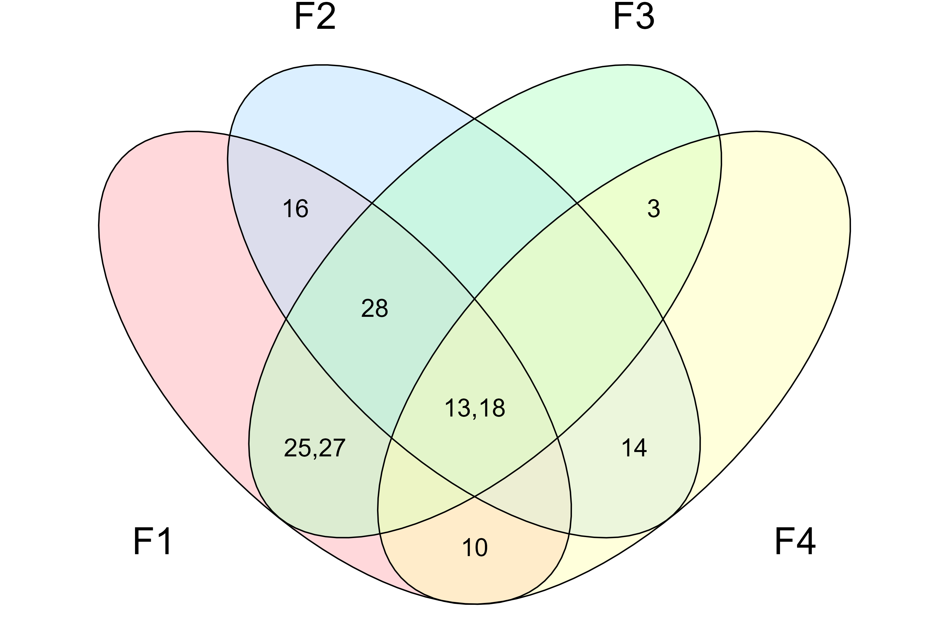
F2 – Networked shocks
F3 – Multilateral governance
The crises are clearly connected. (+)
The list of crises that make up the current polycrisis is clear. (-)
The polycrisis evolves along different temporal scales. (+)
-
Polycrisis disturbs more severely the Global North than the Global South. (-)
The concept is counter productive. (-)
Responses must be coordinated. (+)
-
The concept is a buzzword. (-)
A polycrisis evolves along different spatial scales. (+)
A phenomenon underlying the polycrisis is capitalism. (+)
F1 – Capital-rooted interdependence
F4 – Postcolonialism

